Slide 1
Internet of Things (7CS4-01)
Ms. Kritika Purohit
Assistant Professor
Computer Science & Engineering

Slide 2
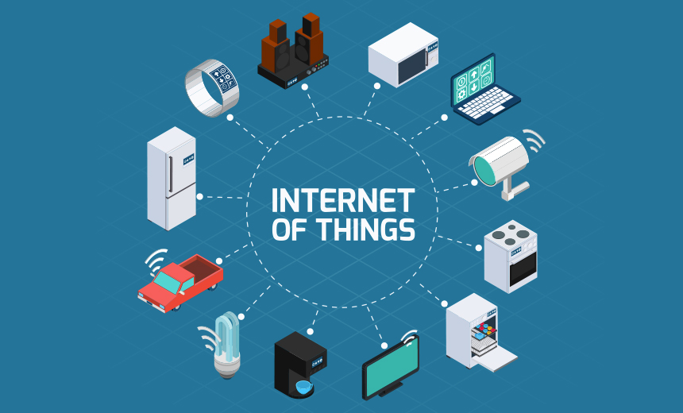
Course description
The course would cover engineering fundamentals, blended with good industrial practices, which lead to the first-time success of the design and development of sensor node. API development, cloud computing, and data analysis would also be covered in brief

Slide 3
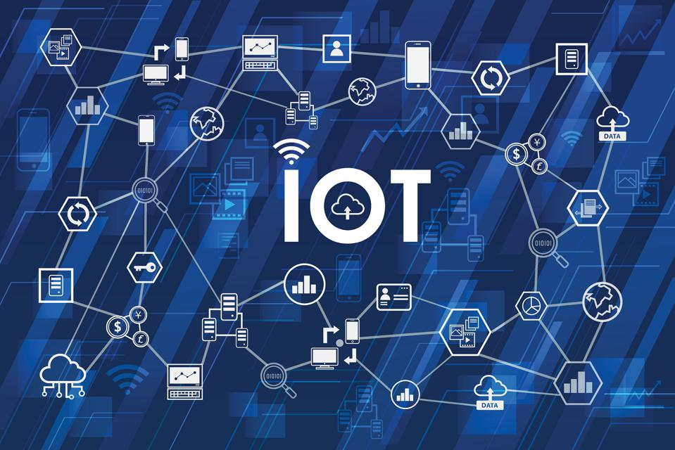
Objective of Subject
This program aims to train students to be equipped with a solid theoretical foundation systematic professional knowledge and strong practical skills in the fields of computer technology communications networks and IT that provides a wide range of applications in the Internet of Things.

Slide 4
Course Outcomes
CO1 : Students will be able to understand building blocks of Internet of Things and characteristics.
CO2: Students will be able to understand IoT sensors and technological challenges faced by IoT devices, with a focus on wireless, energy, power, RF and sensing modules
CO3: Students will be able to understand the key components that make up an IoT system differentiate between the levels of the IoT stack and be familiar with the key technologies and protocols employed at each layer of the stack
CO4: Students will be able to explore and learn about Internet of Things with the help of preparing projects designed for Raspberry Pi
CO5: Students will be able to understand design IoT applications in different domain and be able to analyze their performance

Slide 5
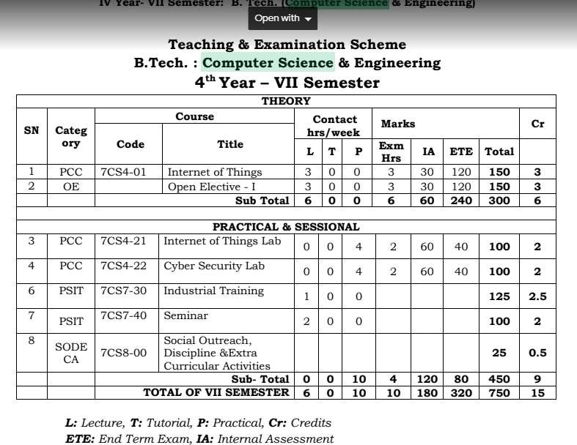
Subject Scheme

Slide 6
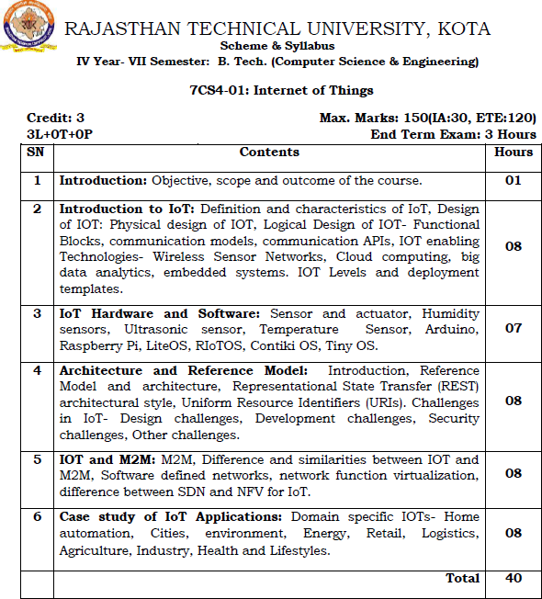

Slide 7
Books
Text Book-
“Internet of Things: A Hands-on Approach” by Vijay Madisetti & Arshdeep Bahga, 2014, ISBN:9780996025515
“Internet of Things” by Raj Kamal, Tata McGraw Hill Publication
Reference Books-
“Designing the Internet of Things” by Adrian McEwen, Wiley Publishers ,2013 , ISBN:978-1-118- 43062-0
“The Silent Intelligence: The Internet of Things” by DanielKellmereit.2013,ISBN0989973700
“The Internet of Things: Connecting Objects” by Hakima Chaouchi Wiley publication.
“MySQL for the Internet of things” by Charless Bell A press publications.
“Rethinking the Internet of things: A scalable Approach to connecting everything” by Francis Dacosta, 1st edition, A press publications 2013.
Internet of Things: Do-It-Yourself at Home Projects for Arduino, Raspberry Pi and Beagle Bone Black” by Donald Norris , The McGraw Hill publication.

Slide 8
Career Opportunities
Career path you can choose after the course
IoT Engineer
Citizen IoT Scientist
IoT App Developer
Machine Learning Engineer
IoT Solution Architect
IoT System Administrator

Slide 9
Companies work in IOT
Algo Engines- They use IoT to analyze and use similar data sets from different turbines, inverters, and other renewable sources of energy to optimize performance and up time to get maximum benefits. With the help of IoT, they are able to provide forecasting services to power producers.
Altiux Innovation- It is a software and product engineering services organization that focuses on developing Internet of Things (IoT) products and services for multiple domains like smart cities, smart homes, industrial IoT, intelligent buildings, semiconductors and many more. Their expertise in M2M, Cloud, Mobility, IoT, and Big Data helps them provide robust solutions in many sectors and domains.

Slide 10
Altizon system- Altizon Systems is a Wipro-backed internet of things company in India which develops solutions based on IoT. Altizon has over 100 Enterprise users, making it a leading Industrial IoT platform provider
Pixel Crayons- It caters to a wide range of domains and verticals, like healthcare, banking and finance, the automotive industry, travel and tourism, media and entertainment, transport and logistics, and e-commerce. They provide end- to-end app development services which can be customized based on client needs.

Slide 11
IBM- They have IoT solutions like:
Enterprise asset management: Using a combination of IoT, AI, and analytics, they help to reduce cost and risk, and improve efficiency.
Facilities management: Helps in making better, faster, and more informed decisions by speeding up the analysis of fetched data.
Systems engineering: Helps in lowering costs by managing requirements, quality, and compliance.
IoT platform: Helps to manage IoT devices and make more efficient decisions using secure data, analytics, and cloud capabilities.
https://www.analyticsinsight.net/top-iot-companies/

Slide 12
Queries…???

